Slide 1
LINUX DEVICE DRIVER
DAY 6 PPT
-SUBITHRA S

Slide 2
GIT COMMANDS
Git init: creates a new git repository in the current directory.
Git clone [repository url]: copies a repository from a remote server to your local machine.
Git add [file]: adds changes in the specified file to the staging area.
Git commit -m "[commit message]": commits the staged changes with a descriptive message.
Git status: shows the current status of the repository, including staged and unstaged changes.

Slide 3
GIT COMMANDS
Git branch: lists all branches in the repository.
Git checkout [branch name]: switches to the specified branch.
Git merge [branch name]: combines changes from the specified branch into the current branch.
Git pull: fetches changes from the remote repository and merges them into the current branch.
Git push: uploads committed changes to the remote repository.
Git log: displays a log of commits, including commit messages and authors

Slide 4
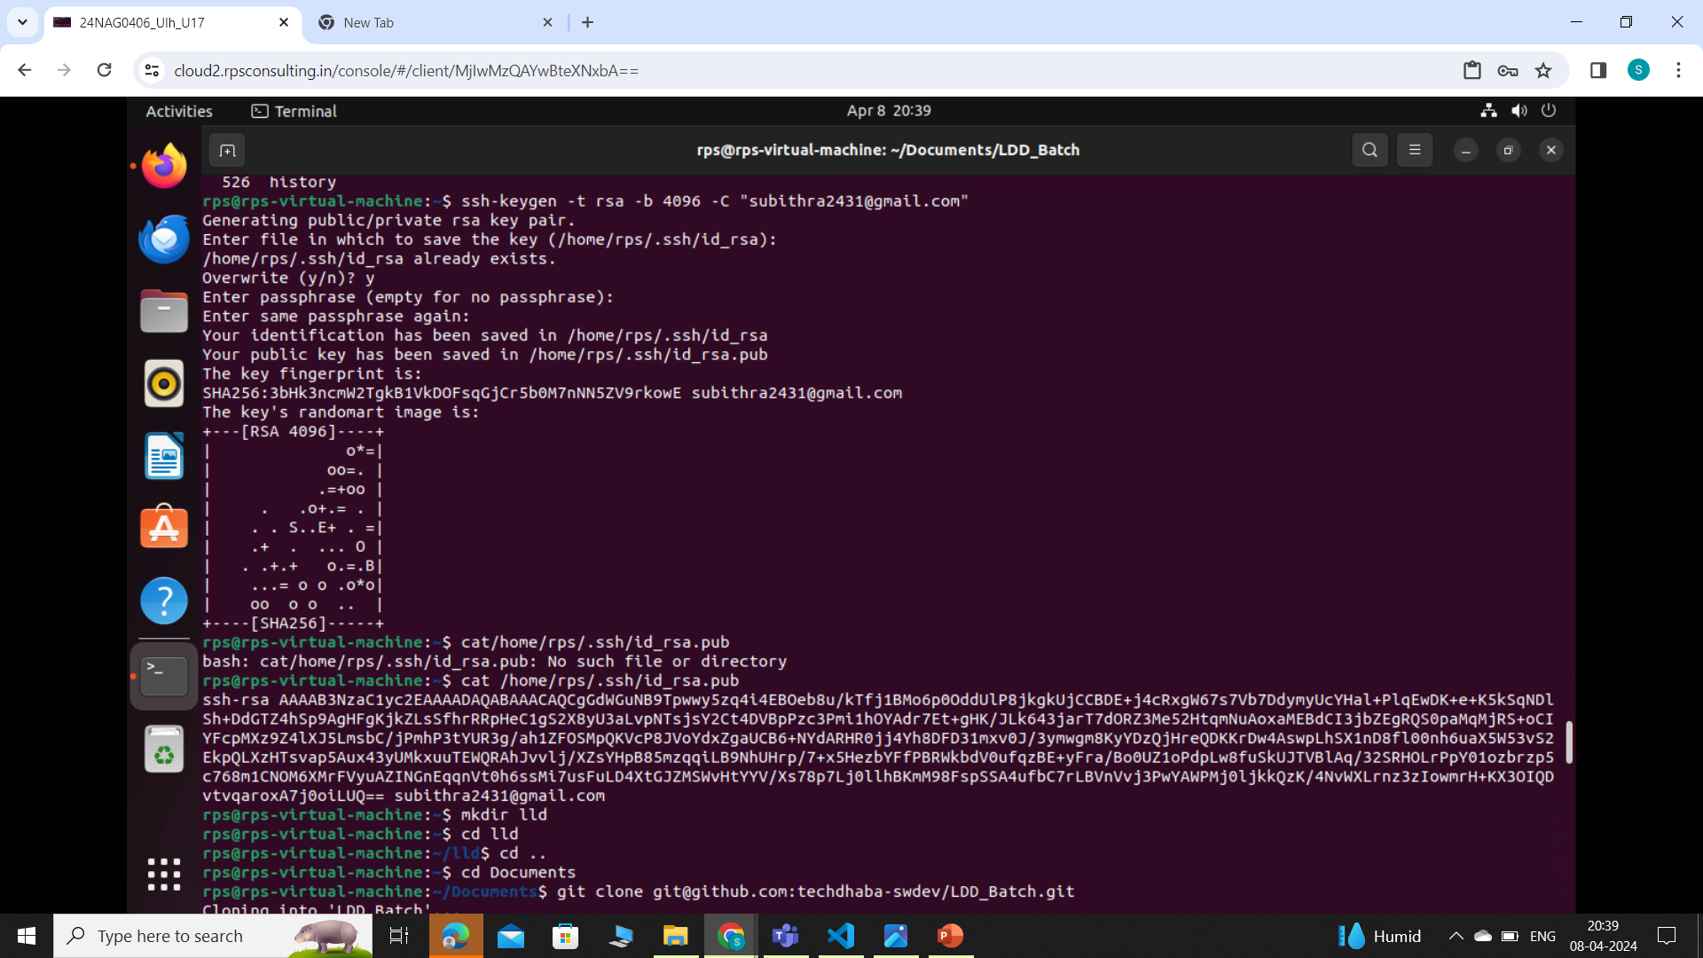
GETTING SSH KEY

Slide 5
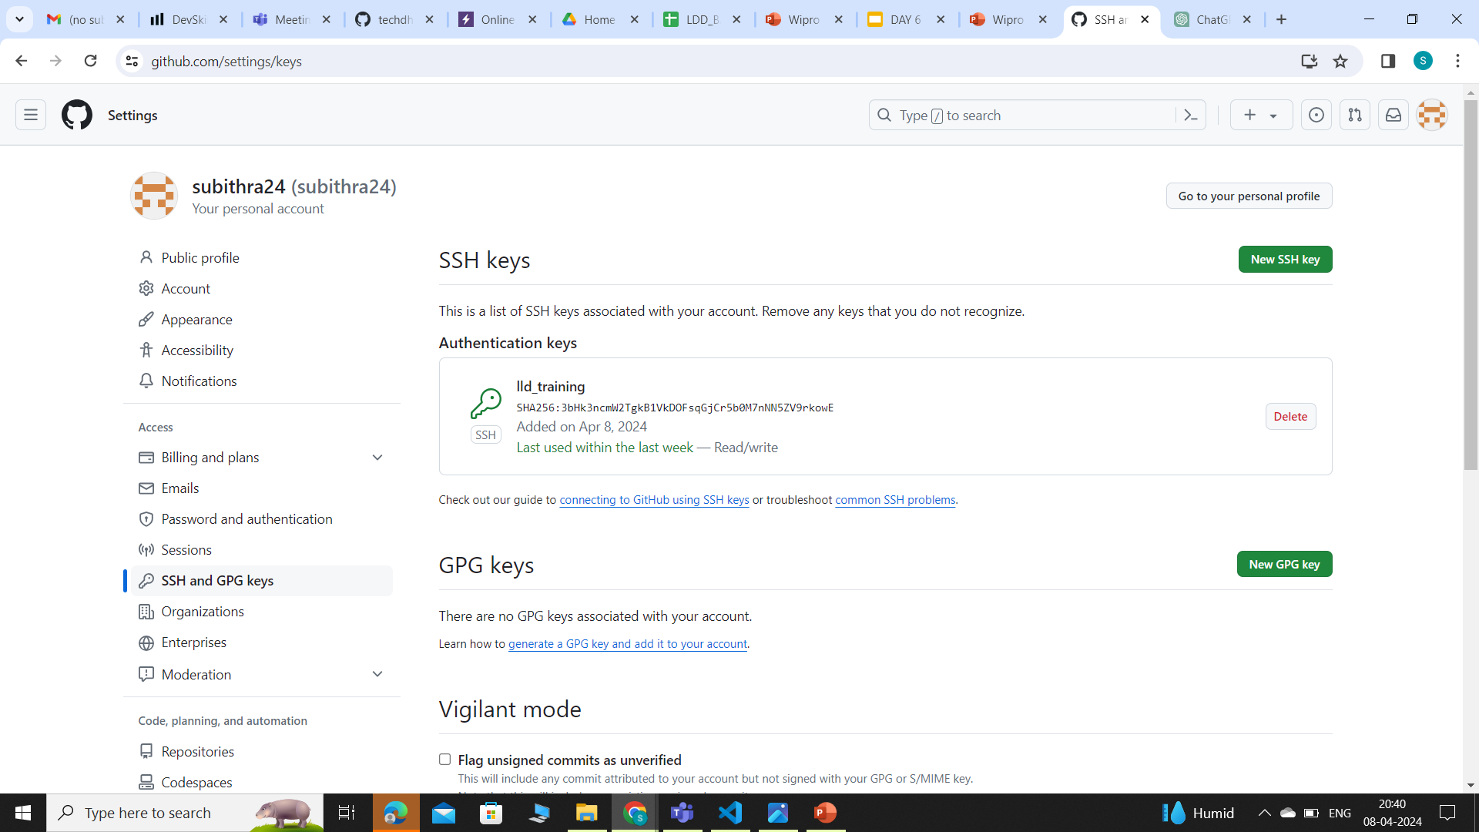
PASTING THE SSH KEY IN A FOLDER BY NAMING IT

Slide 6
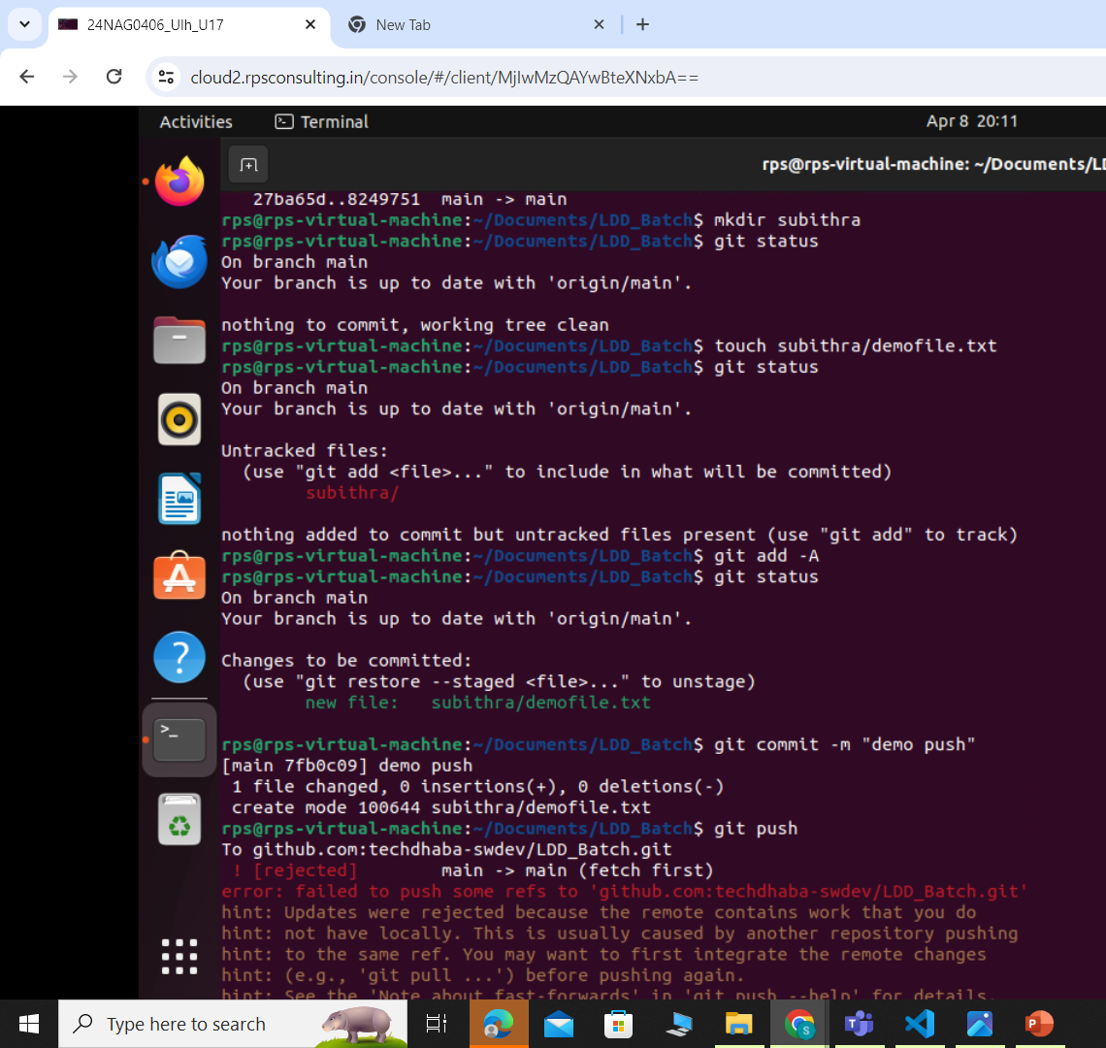
PUSHING TO GIT

Slide 7
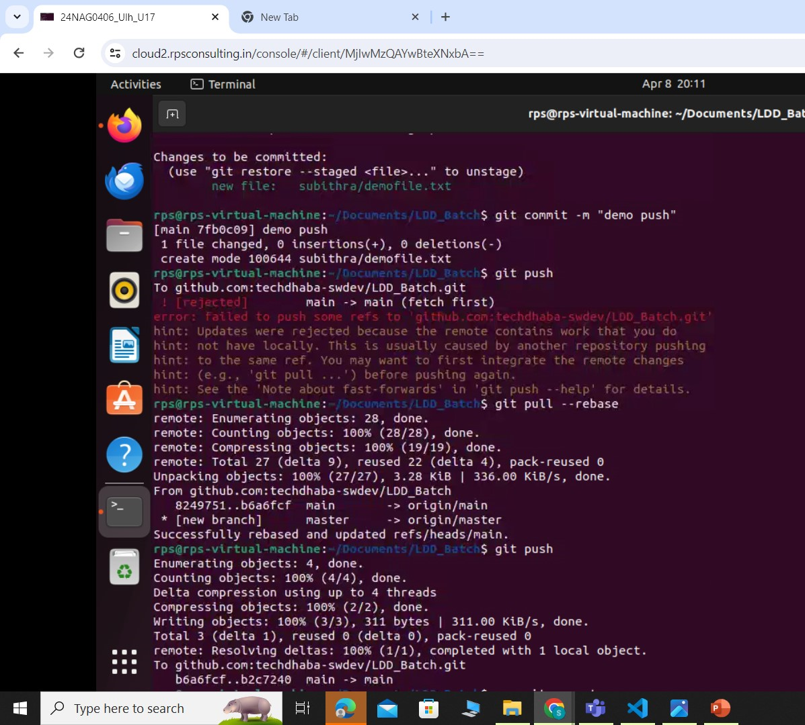
PUSHING TO GIT

Slide 8
THANK YOU

